Slide 1

Antisocial behaviour
AEPSY Year 11 ATAR Psychology

Slide 2
Review
What were the findings of Asch’s Line Judgement Task Experiment?
Which ethical consideration did both Asch’s Line Judgement and Milgram’s Obedience study breach? Why? How could this be overcome?
List Kelman’s 3 processes of influence?
Distinguish between direct and indirect discrimination.
List the three phases of Tajfel and Turner’s Social Identity Theory.

Slide 3
Review
People would conform depending on group size (3-5), unanimity, informative influence (not sure of their own knowledge/skills) and to an extent whether their responses were anonymous or not.
Deception (and possibly psychological harm). Part of the experiment. Overcome with debriefing.
Compliance, identification, internalisation.
Direct – targeted and intentional; Indirect – unintentional due to conditions that apply to everyone.
Social categorisation; social identification; social comparison

Slide 4
Learning Intentions
antisocial behaviour in response to social influence
factors influencing antisocial behaviour – diffusion of responsibility, audience inhibition, social influence, cost–benefit analysis, groupthink
concept of bystander effect
study: Group inhibition of bystander intervention in emergencies – smoke filled room (Latane and Darley, 1968)
bullying as an example of antisocial behaviour

Slide 5
Success Criteria
Define antisocial behaviour
List five factors influencing antisocial behaviour
Explain the bystander effect
Summarise the Smoke –filled room experiment
Explain bullying as an example of antisocial behaviour.

Slide 6
Antisocial behaviour
Behaviour that harms society and its members by violating the rights of others.

Slide 7


Slide 8
The Bystander Effect
A bystander becomes aware of a potential emergency, but decides not to act or intervene. The more people present, the less likely they are to help.

Slide 9


Slide 10
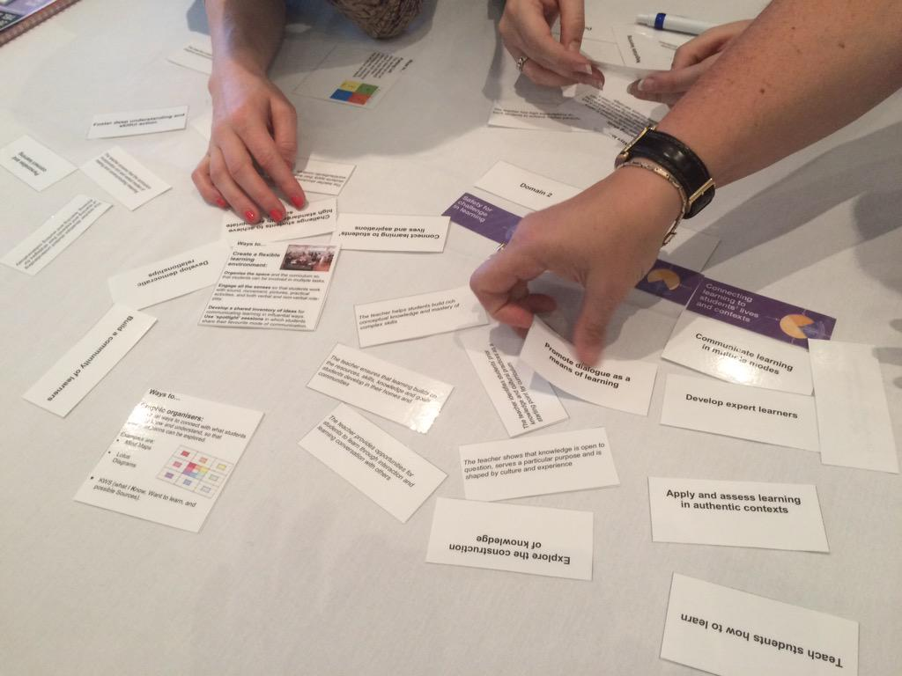
Factors affecting antisocial behaviour
Diffusion of responsibility
Audience inhibition
Social influence
Cost-benefit analysis
Groupthink

Slide 11
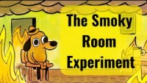

Slide 12
Bullying
The purposeful use of a difference in power to repeatedly cause physical, psychological or social harm.

Slide 13
Success Criteria
Define antisocial behaviour
List five factors influencing antisocial behaviour
Explain the bystander effect
Summarise the Smoke –filled room experiment
Explain bullying as an example of antisocial behaviour.

Slide 14


